Slide 1
Welcome to Psy 652 Lab! Module 12: Factorial ANOVA

Slide 2
Objectives
Really quick rundown of factorial ANOVA
Dataset description
Coding tutorial

Slide 3
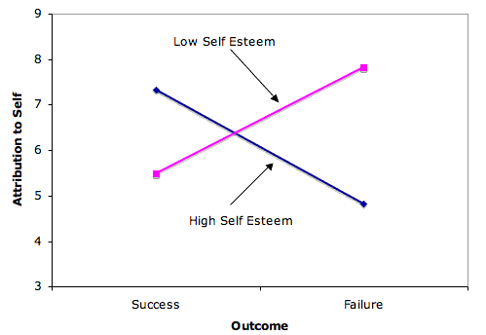
Factorial ANOVA
Pretty similar to last week… Except now we have TWO OR MORE independent variables
We’ll be analyzing if the levels of our IVs differ and additionally analyzing if the interaction between those IVs.
Interaction effect means analyzing if the Slopes between two groups differ.

Slide 4
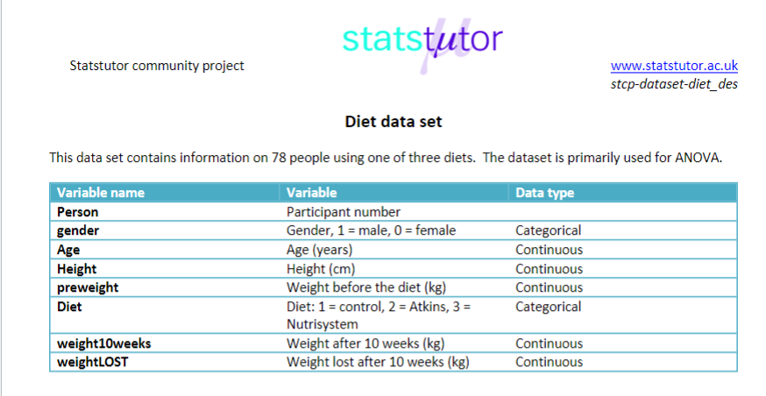

Slide 5
Let’s code!

